Slide 1
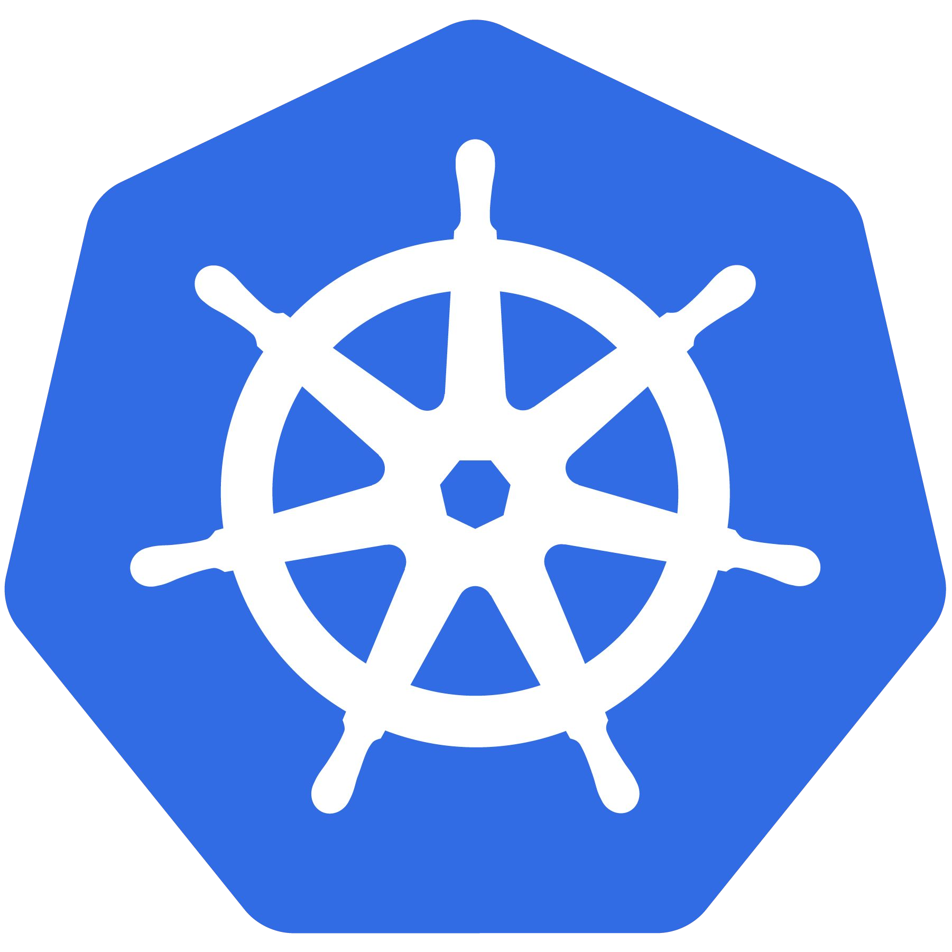
Kubernetes
An Introduction
Kubernetes

Slide 2

Pre-Requisites
Docker
YAML
Virtual Box to Setting up Lab environment,
AWS
Linux

Slide 3
$ whoami - Aneesh
Sr. Devops Eng. @ MNC
Part time Freelancer
Trainer in following technology
Linux, Docker, Kubernetes, DevOps

Slide 4
Overview

Slide 5
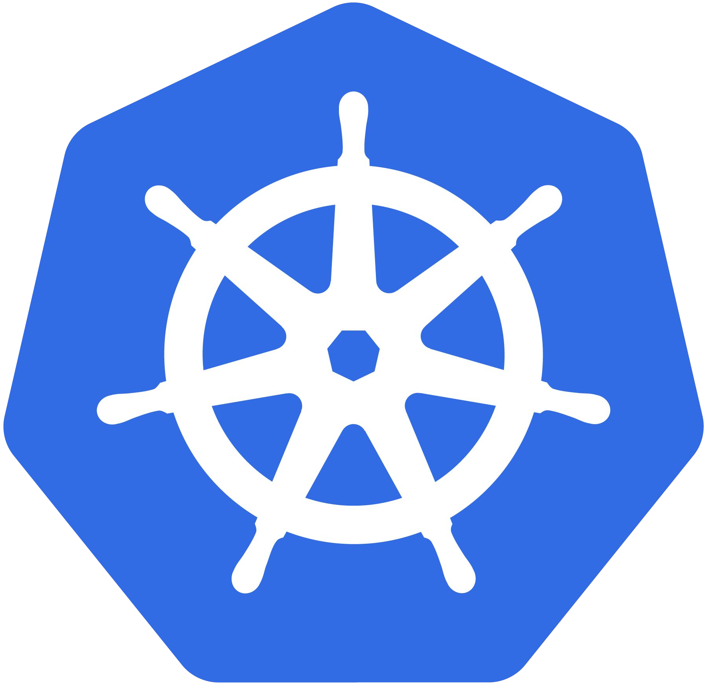
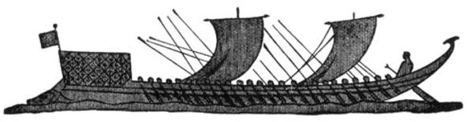
What Does “Kubernetes” Mean?
Greek for “pilot” or “Helmsman of a ship”
Image Source

Slide 6
What is Kubernetes?
Kubernetes is an open-source Container Management tool which automates container deployment, container (de)scaling & container load balancing.
Written on Golang, it has a huge community because it was first developed by Google & later donated to CNCF
Can group ‘n’ no of containers into one logical unit for managing & deploying them
Built from the lessons learned in the experiences of developing and running Google’s Borg and Omega.

Slide 7
Decouples Infrastructure and Scaling
All services within Kubernetes are natively Load Balanced.
Can scale up and down dynamically.
Used both to enable self-healing and seamless upgrading or rollback of applications.

Slide 8
Self Healing
Kubernetes will ALWAYS try and steer the cluster to its desired state.
Me: “I want 3 healthy instances of redis to always be running.”
Kubernetes: “Okay, I’ll ensure there are always 3 instances up and running.”
Kubernetes: “Oh look, one has died. I’m going to attempt to spin up a new one.”

Slide 9

Most Importantly...
Use the SAME API across bare metal and EVERY cloud provider!!!

Slide 10

Who “Manages” Kubernetes?
The CNCF is a child entity of the Linux Foundation and operates as a vendor neutral governance group.

Slide 11
A Couple Key Concepts...

Slide 12
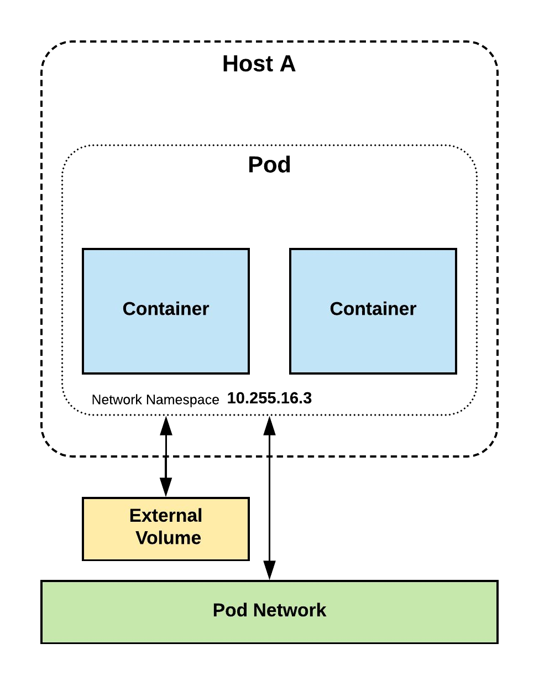
Pods
Atomic unit or smallest “unit of work”of Kubernetes.
Pods are one or MORE containers that share volumes, a network namespace, and are a part of a single context.

Slide 13
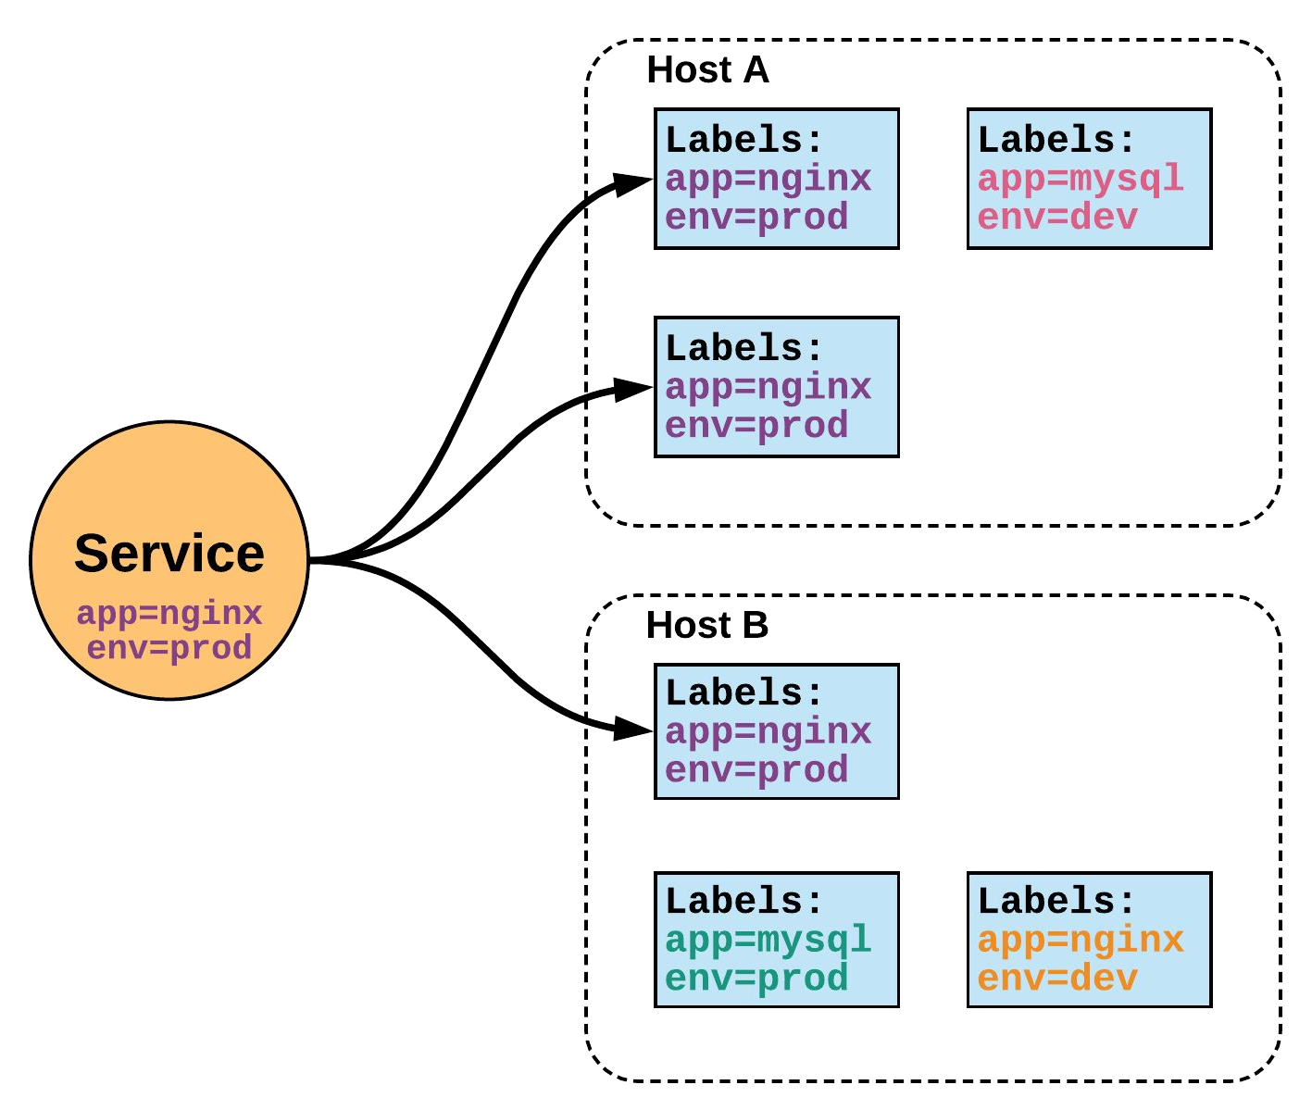
Services
Unified method of accessing
the exposed workloads of Pods.
Durable resource
static cluster IP
static namespaced DNS name

Slide 14
Architecture Overview

Slide 15
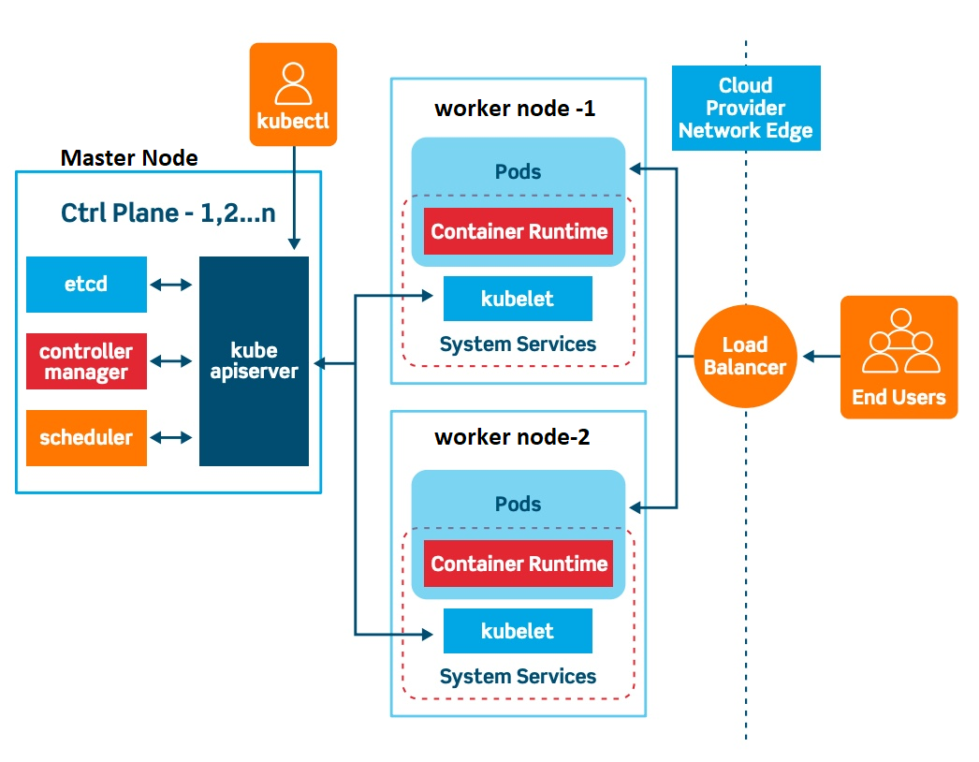
2379

Slide 16
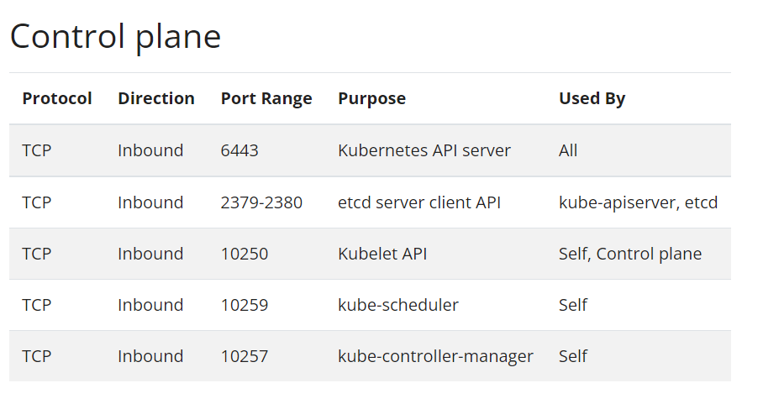
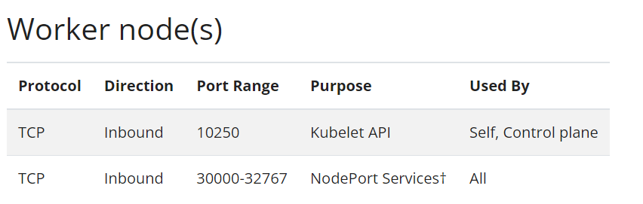

Slide 17

Control Plane Components
Architecture Overview

Slide 18
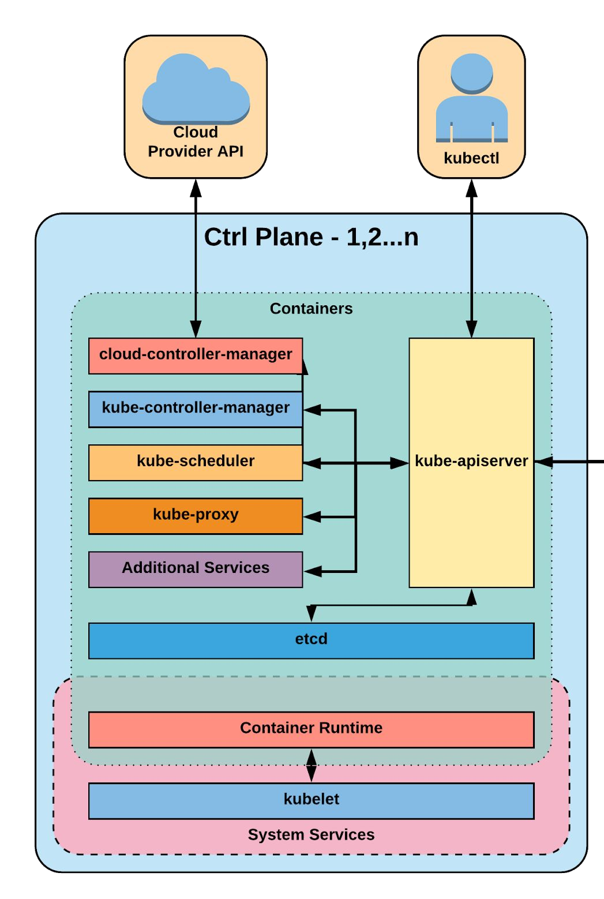
Control Plane Components
kube-apiserver
etcd
kube-controller-manager
kube-scheduler

Slide 19
kube-apiserver
Provides a forward facing REST interface into the kubernetes control plane and datastore.
All clients and other applications interact with kubernetes strictly through the API Server.
Acts as the gatekeeper to the cluster by handling authentication and authorization, request validation, mutation, and admission control in addition to being the front-end to the backing datastore.

Slide 20
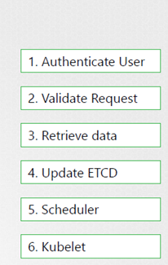
kube-apiserver

Slide 21

etcd
etcd acts as the cluster datastore.
Purpose in relation to Kubernetes is to provide a strong, consistent and highly available key-value store for persisting cluster state.
Stores objects and config information.
If you setup cluster via kubeadm , than kubeadm will set a etcd in pod in kube-system namespace.

Slide 22
kube-controller-manager
Serves as the primary daemon that manages all core component control loops.
Monitors the cluster state via the apiserver and steers the cluster towards the desired state.
Node and Replication Controller

Slide 23
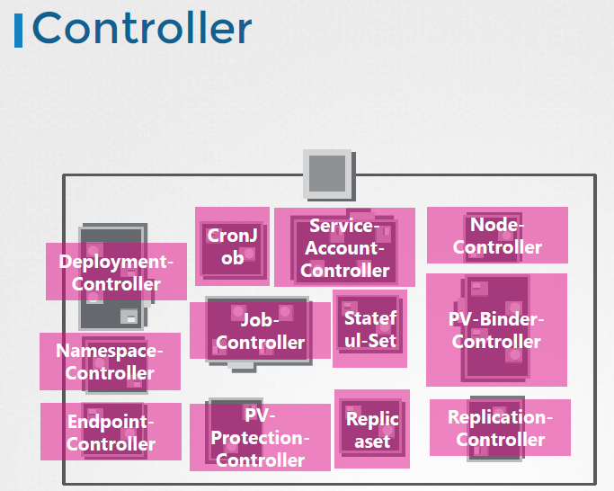

Slide 24
kube-scheduler
Verbose policy-rich engine that evaluates workload requirements and attempts to place it on a matching resource.
Scheduler only decides where pod will be deployed, than kubelet creates pod
Workload Requirements can include: general hardware requirements, affinity/anti-affinity, labels, and other various custom resource requirements.

Slide 25
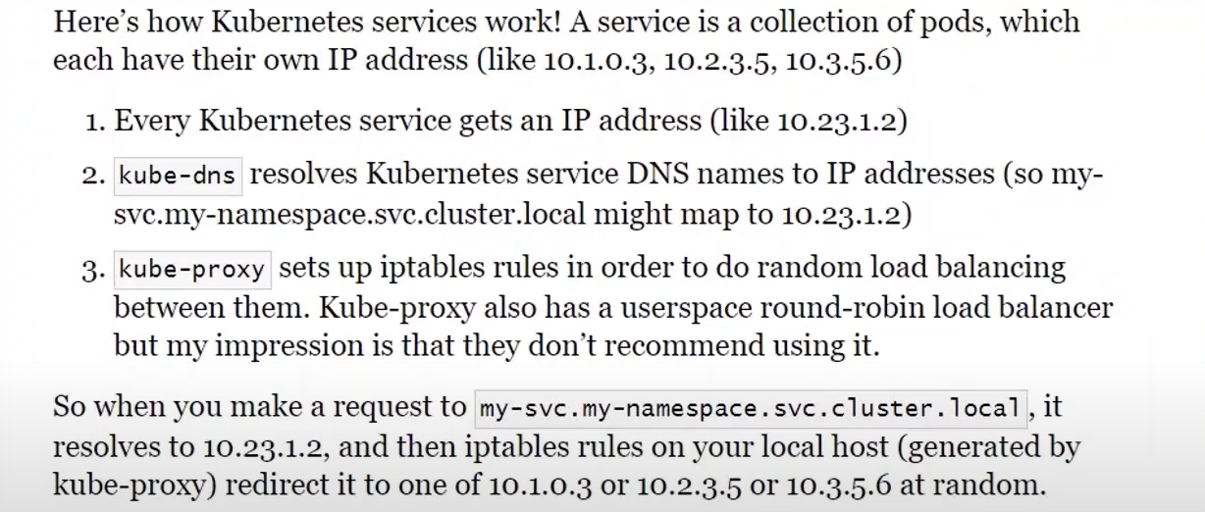
kube-dns/proxy

Slide 26
Networking
Architecture Overview

Slide 27
Kubernetes Networking
Pod Network
Cluster-wide network used for pod-to-pod communication managed by a CNI (Container Network Interface) plugin.
Service Network
Cluster-wide range of Virtual IPs managed by
kube-proxy for service discovery.

Slide 28
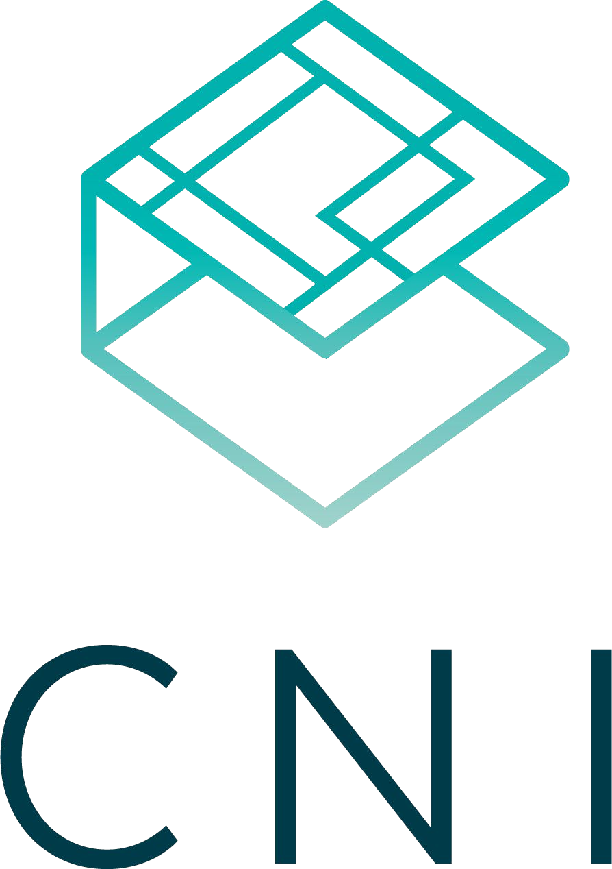
Container Network Interface (CNI)
Pod networking within Kubernetes is plumbed via the Container Network Interface (CNI).
Functions as an interface between the container runtime and a network implementation plugin.
CNCF Project
Uses a simple JSON

Slide 29
Every Pod should have an IP address
Every Pod should be able to communicate with other POD in same node
Every Pod should be able to communicate with other POD on other nodes
Master Node
Node1
Node2
Pod
10.1.2.3
Pod
10.1.2.5
Pod
10.1.2.7
Pod
10.1.2.4
Pod
10.1.2.6
Pod
10.1.2.8

Slide 30

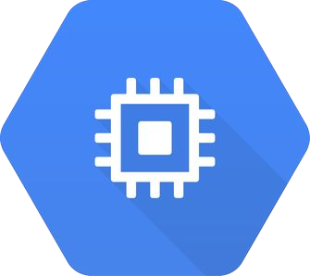
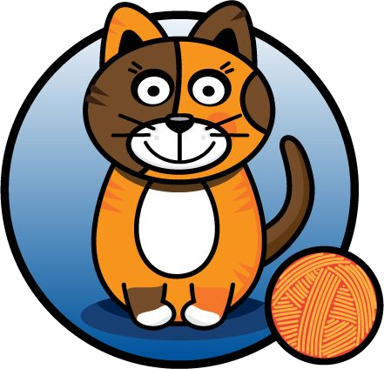

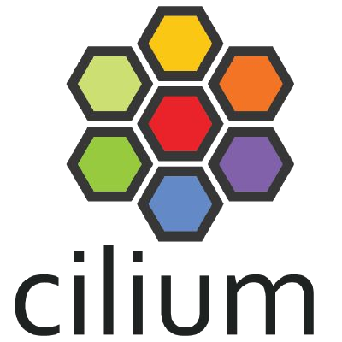




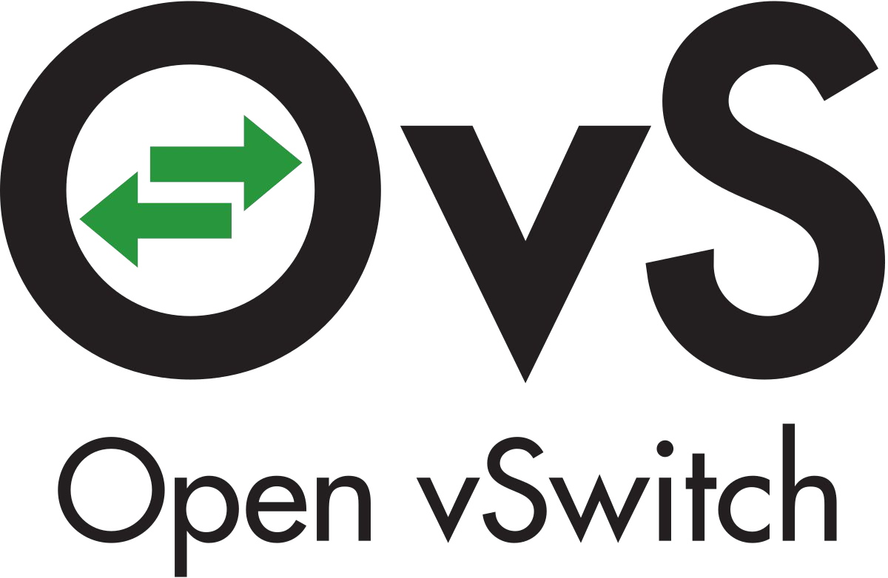


CNI Plugins
Amazon ECS
Calico
Cillium
Contiv
Contrail
Flannel
GCE
kube-router
Multus
OpenVSwitch
Romana
Weave

Slide 31
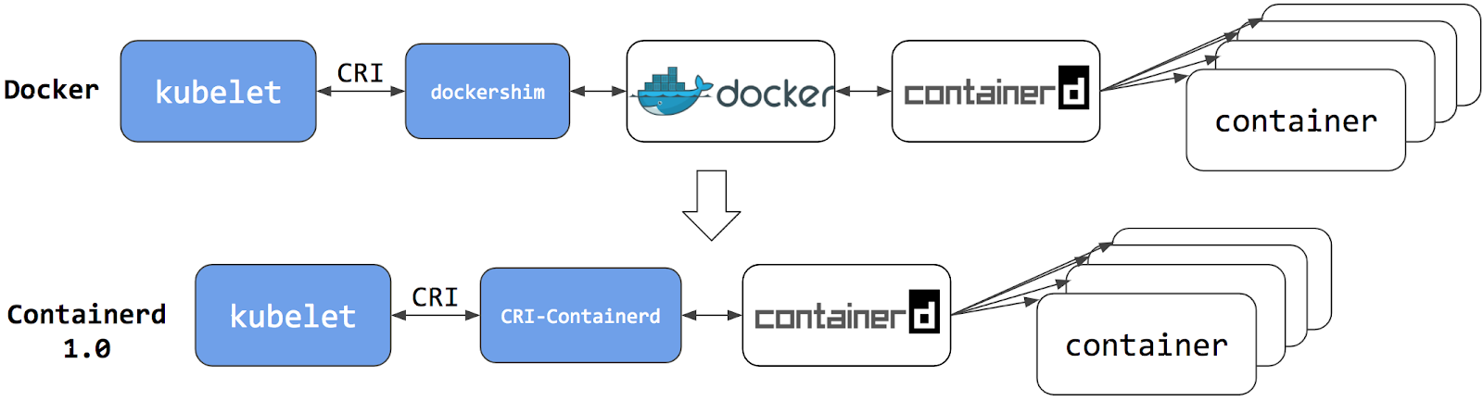

Slide 32
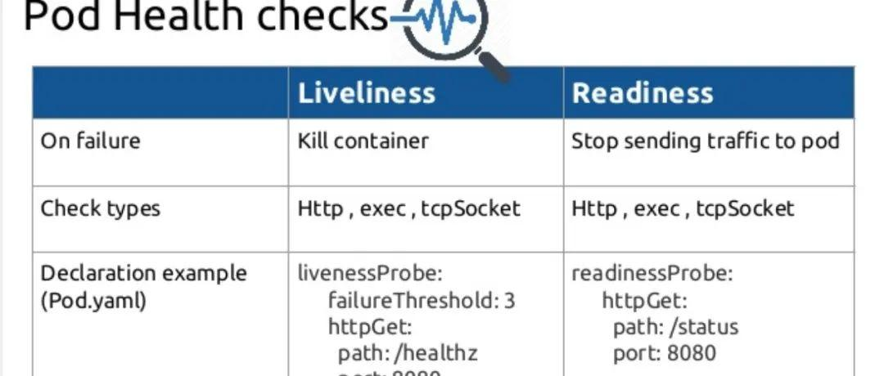

Slide 33
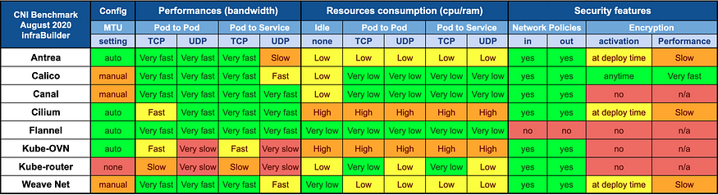

Slide 34
Taints and Tolerations
Taints are set on Node
Tolerations are set on POD
#kubectl taint nodes node-name key=value:taint effect
Pod
Pod
NoSchedule , PreferNoSchedule, NoExecute
Pod
Pod
Taint=Green: NoExecute
#kubectl taint nodes node1 app=myapp:NoSchedule
Node1
Node2
Node3
NoSchedule instructs Kubernetes scheduler not to schedule any new pods to the node unless the pod tolerates the taint..
PreferNoSchedule then Kubernetes will try to not schedule the pod onto the node but no guaranty.
NoExecute new pod will not be scheduled and existing pod will be evicted if they do not tolerate the taint.
taints and toleration does not tell the POD to go to a particular
node. Instead it tells the node to only accept PODs with certain toleration.
If your requirement is to restrict a POD to certain nodes, it is achieved through node affinity.

Slide 35
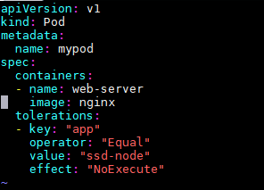
Taints and Tolerations
Taints are set on Node
Tolerations are set on POD
#kubectl describe nodes server | grep “Taint”
Pod
Pod
Pod
Pod
Taints=Green
Master Node
Node1
Node2
Node3
#kubectl taint nodes NODE-NAME key-

